Slide 1
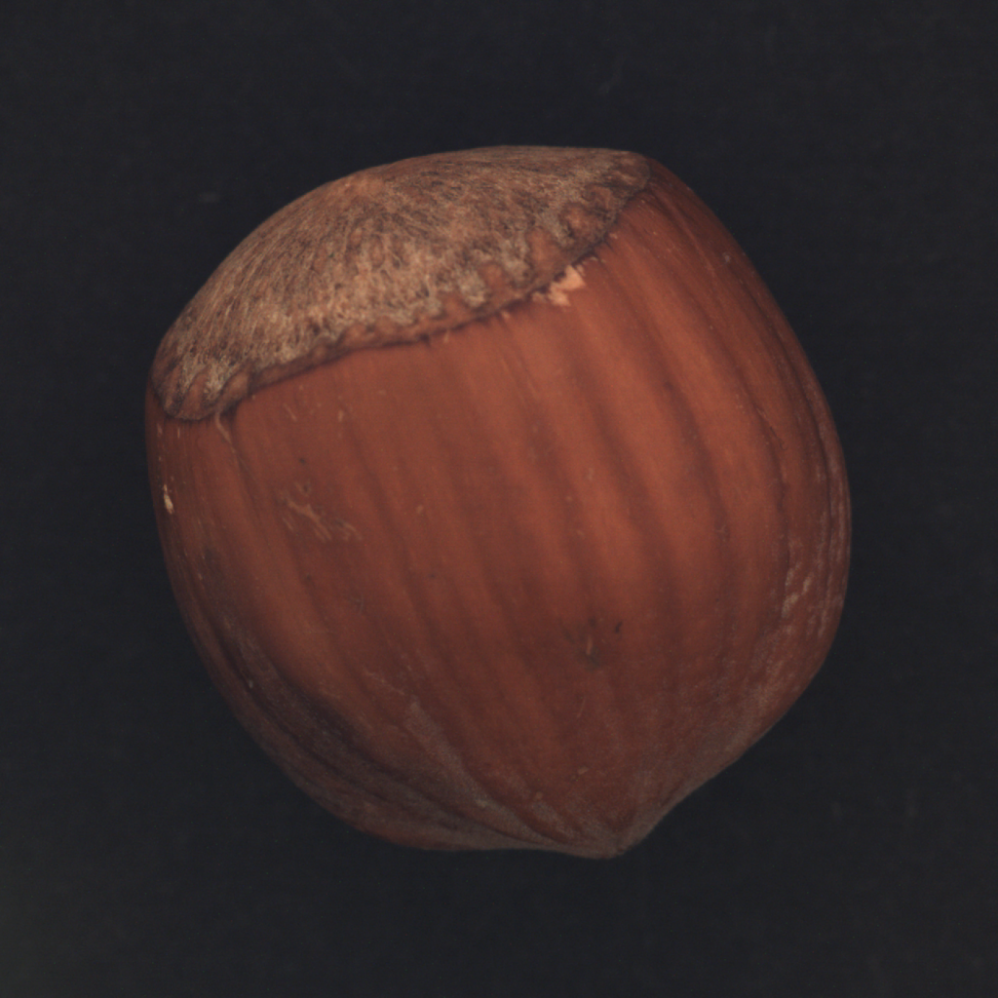
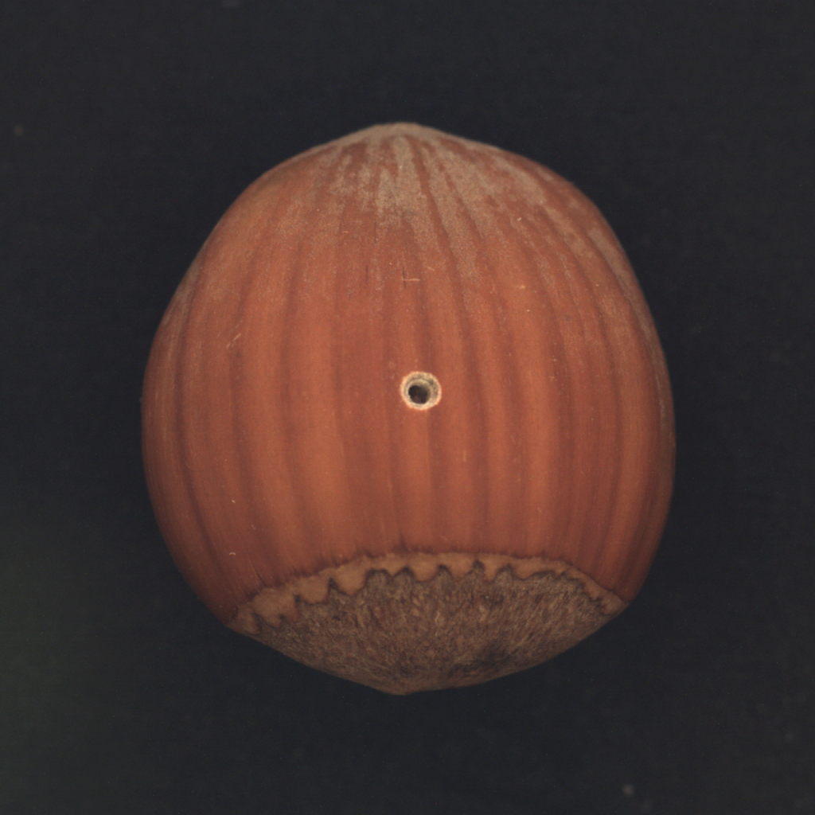
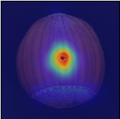
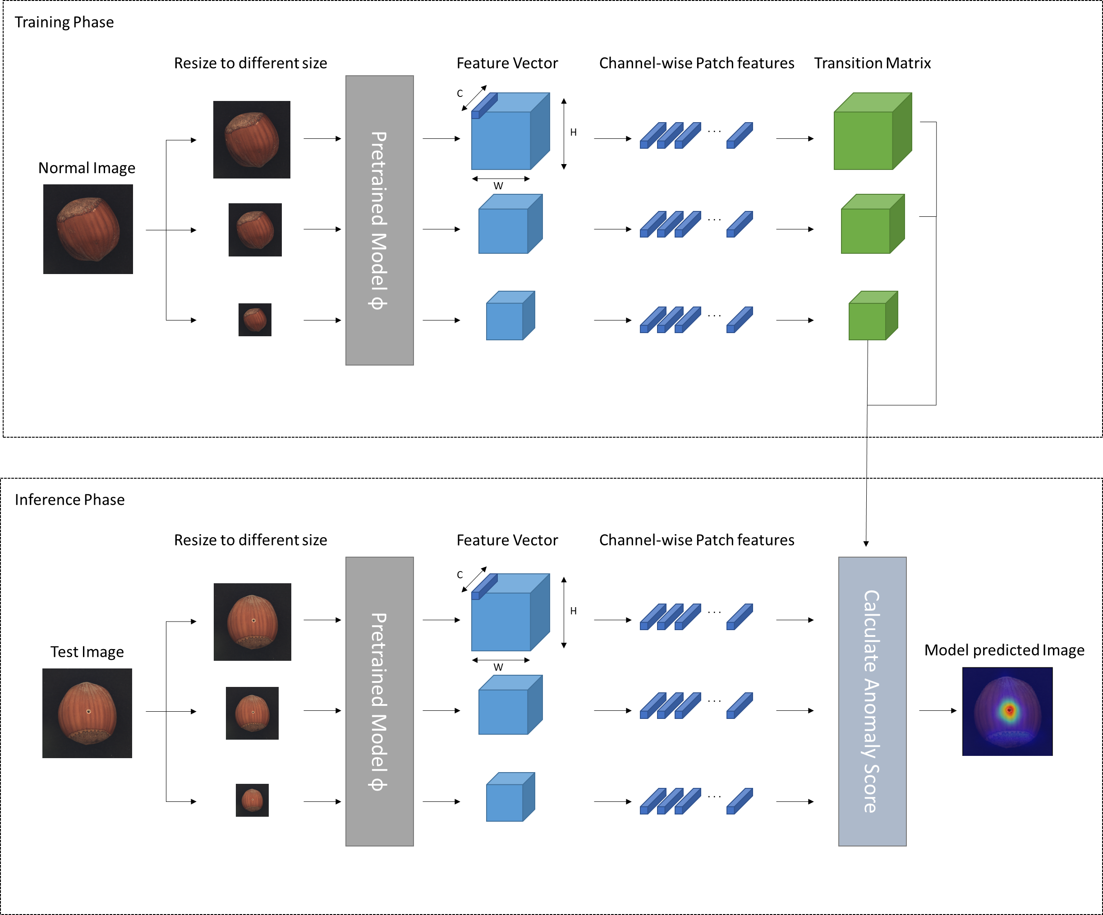
Training Phase
Resize to different size
Pretrained Model ф
Feature Vector
Channel-wise Patch features
Transition Matrix
Normal Image
C
H
∙ ∙ ∙
W
∙ ∙ ∙
∙ ∙ ∙
Inference Phase
Resize to different size
Pretrained Model ф
Feature Vector
Channel-wise Patch features
Calculate Anomaly Score
Test Image
C
H
∙ ∙ ∙
Model predicted Image
W
∙ ∙ ∙
∙ ∙ ∙

